Slide 1
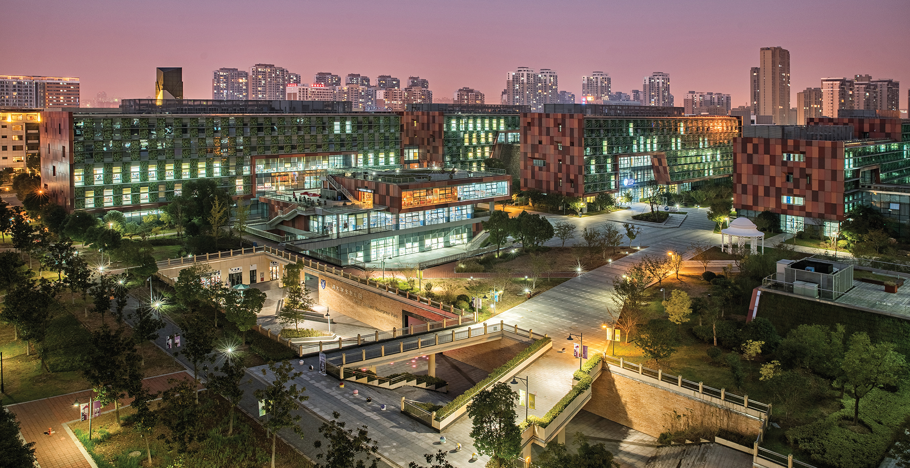

Tutorial of Week 11
INT301 Bio-computation, Week 11, 2025
Notes:
Images should be RGB colour setting
Header: Uppercase, Calibri size 28, XJTLU Navy
Body Text: Sentence case, Calibri size 14, Black

Slide 2
Example of Simple Competitive Learning
We are given 6 data samples:
3 ouput units each associated with a prototype vector.
Learning rate: 0.5
You are required to update the prototype vectors using Simple Competitive Learning (SCL) according to such upadating rule:
[0 1 1] [1 1 0.5] [0.2 0.2 0.2]
[0.5 0.5 0.5] [0.4 0.6 0.5] [0 0 0]

Slide 3
Example of Simple Competitive Learning
Question 1: The 3 prototype vectors are randomly initialized as:
and the winner units are determined by minimizing the Euclidean distance. Please upadate the vectors one epoch and list the clustering result.
[0.14 0.75 0.71] [ 0.99 0.51 0.37 ] [ 0.73 0.81 0.87 ]
Training on Input Vectors
Input vector # 1: [ 0.00 1.00 1.00 ]
Computing the distance beween Input vector to each prototype vector:
[0.14 0.75 0.71] [ 0.99 0.51 0.37 ] [ 0.73 0.81 0.87 ]
0.1662 1.6171 0.5859
Winning weight vector # 1: [ 0.14 0.75 0.71 ]
Updated winning weight vector:
[ 0.14 0.75 0.71 ]+0.5*([ 0.00 1.00 1.00 ]-[ 0.14 0.75 0.71 ])
[ 0.07 0.87 0.85 ][ 0.99 0.51 0.37 ] [ 0.73 0.81 0.87 ]

Slide 4
Example of Simple Competitive Learning
Training on Input Vectors
Input vector # 2: [ 1.00 1.00 0.5 ]
Computing the distance beween Input vector to each prototype vector:
[0.07 0.87 0.85] [ 0.99 0.51 0.37 ] [ 0.73 0.81 0.87 ]
1.0043 0.2571 0.2459
Winning weight vector # 3: [ 0.73 0.81 0.87 ]
Updated winning weight vector:
[ 0.73 0.81 0.87 ]+0.5*([ 1.00 1.00 0.5 ]-[ 0.73 0.81 0.87 ])
[ 0.07 0.87 0.85 ][ 0.99 0.51 0.37 ] [ 0.87 0.90 0.69]

Slide 5
Example of Simple Competitive Learning
Training on Input Vectors
Input vector # 3: [ 0.2 0.2 0.2 ]
Computing the distance beween Input vector to each prototype vector:
[0.07 0.87 0.85] [ 0.99 0.51 0.37 ] [0.87 0.90 0.69 ]
0.8883 0.7491 1.1790
Winning weight vector # 2: [ 0.99 0.51 0.37 ]
Updated winning weight vector:
[ 0.99 0.51 0.37 ]+0.5*([ 0.2 0.2 0.2 ]-[ 0.99 0.51 0.37 ])
[ 0.07 0.87 0.85 ][ 0.59 0.36 0.29 ] [ 0.87 0.90 0.69]

Slide 6
Example of Simple Competitive Learning
Training on Input Vectors
Input vector # 4: [ 0.5 0.5 0.5 ]
Computing the distance beween Input vector to each prototype vector:
[0.07 0.87 0.85] [ 0.59 0.36 0.29 ] [0.87 0.90 0.69 ]
0.4443 0.0718 0.3330
Winning weight vector # 2: [ 0.59 0.36 0.29 ]
Updated winning weight vector:
[ 0.59 0.36 0.29 ]+0.5*([ 0.5 0.5 0.5 ]-[ 0.59 0.36 0.29 ])
[ 0.07 0.87 0.85 ][ 0.55 0.43 0.39 ] [ 0.87 0.90 0.69]

Slide 7
Example of Simple Competitive Learning
Training on Input Vectors
Input vector # 5: [ 0.4 0.6 0.5 ]
Computing the distance beween Input vector to each prototype vector:
[0.07 0.87 0.85] [ 0.55 0.43 0.39 ] [0.87 0.90 0.69 ]
0.3043 0.0635 0.3470
Winning weight vector # 2: [ 0.59 0.36 0.29 ]
Updated winning weight vector:
[ 0.55 0.43 0.39 ]+0.5*([ 0.4 0.6 0.5 ]-[ 0.55 0.43 0.39 ])
[ 0.07 0.87 0.85 ][ 0.47 0.51 0.45 ] [ 0.87 0.90 0.69]

Slide 8
Example of Simple Competitive Learning
Training on Input Vectors
Input vector # 6: [ 0.0 0.0 0.0 ]
Computing the distance beween Input vector to each prototype vector:
[0.07 0.87 0.85] [ 0.47 0.51 0.45 ] [0.87 0.90 0.69 ]
1.4843 0.6835 2.0430
Winning weight vector # 2: [ 0.47 0.51 0.45 ]
Updated winning weight vector:
[ 0.47 0.51 0.45 ]+0.5*([ 0.0 0.0 0.0 ]-[ 0.47 0.51 0.45 ])
[ 0.07 0.87 0.85 ][ 0.24 0.26 0.22 ] [ 0.87 0.90 0.69]
Finish of Epoch 1

Slide 9
Example of Simple Competitive Learning
Clusters after epoch 1:
Weight vector # 1: [ 0.07 0.87 0.85 ]
Input vector # 1: [ 0.00 1.00 1.00 ]
Weight vector # 2: [ 0.24 0.26 0.22 ]
Input vector # 3: [ 0.20 0.20 0.20 ]
Input vector # 4: [ 0.50 0.50 0.50 ]
Input vector # 5: [ 0.40 0.60 0.50 ]
Input vector # 6: [ 0.00 0.00 0.00 ]
Weight vector # 3: [ 0.87 0.90 0.69 ]
Input vector # 2: [ 1.00 1.00 0.50 ]

Slide 10
Example of Simple Competitive Learning
Question 2: Based on the 3 prototype vectors initialized in question 1 and the winner units are determined by maximizing inner product. Please upadate the vectors one epoch and list the clustering result again.
Training on Input Vectors
Input vector # 1: [ 0.00 1.00 1.00 ]
Computing the distance beween Input vector to each prototype vector:
[0.14 0.75 0.71] [ 0.99 0.51 0.37 ] [ 0.73 0.81 0.87 ]
1.4600 0.8800 1.6800
Winning weight vector # 3: [ 0.73 0.81 0.87 ]
Updated winning weight vector:
[ 0.73 0.81 0.87 ]+0.5*([ 0.00 1.00 1.00 ]-[ 0.73 0.81 0.87 ])
[ 0.14 0.75 0.71 ][ 0.99 0.51 0.37 ] [ 0.37 0.91 0.94 ]

Slide 11
Example of Simple Competitive Learning
Training on Input Vectors
Input vector # 2: [ 1.00 1.00 0.5 ]
Computing the distance beween Input vector to each prototype vector:
[0.14 0.75 0.71] [ 0.99 0.51 0.37 ] [ 0.37 0.91 0.94 ]
1.2450 1.6850 1.7500
Winning weight vector # 3: [ 0.37 0.91 0.94 ]
Updated winning weight vector:
[ 0.37 0.91 0.94 ]+0.5*([ 1.00 1.00 0.5 ]-[ 0.37 0.91 0.94 ])
[ 0.14 0.75 0.71 ][ 0.99 0.51 0.37 ] [ 0.69 0.96 0.72]

Slide 12
Example of Simple Competitive Learning
Training on Input Vectors
Input vector # 3: [ 0.2 0.2 0.2 ]
Computing the distance beween Input vector to each prototype vector:
[0.14 0.75 0.71] [ 0.99 0.51 0.37 ] [0.69 0.96 0.72 ]
0.3200 0.3740 0.4740
Winning weight vector # 3: [0.69 0.96 0.72 ]
Updated winning weight vector:
[ 0.69 0.96 0.72]+0.5*([ 0.2 0.2 0.2 ]-[ 0.69 0.96 0.72 ])
[ 0.14 0.75 0.71 ][ 0.99 0.51 0.37 ] [ 0.45 0.58 0.46]

Slide 13
Example of Simple Competitive Learning
Training on Input Vectors
Input vector # 4: [ 0.5 0.5 0.5 ]
Computing the distance beween Input vector to each prototype vector:
[0.14 0.75 0.71] [ 0.99 0.51 0.37 ] [0.45 0.58 0.46 ]
0.8000 0.9350 0.7450
Winning weight vector # 2: [ 0.99 0.51 0.37 ]
Updated winning weight vector:
[ 0.99 0.51 0.37]+0.5*([ 0.5 0.5 0.5 ]-[ 0.99 0.51 0.37])
[ 0.14 0.75 0.71 ][ 0.71 0.51 0.44 ] [ 0.45 0.58 0.46]

Slide 14
Example of Simple Competitive Learning
Training on Input Vectors
Input vector # 5: [ 0.4 0.6 0.5 ]
Computing the distance beween Input vector to each prototype vector:
[0.14 0.75 0.71] [ 0.71 0.51 0.44 ] [0.45 0.58 0.46 ]
0.8610 0.8100 0.7580
Winning weight vector # 1: [ 0.14 0.75 0.71 ]
Updated winning weight vector:
[ 0.14 0.75 0.71 ]+0.5*([ 0.4 0.6 0.5 ]-[ 0.14 0.75 0.71 ])
[ 0.27 0.68 0.61 ][ 0.71 0.51 0.44 ] [ 0.45 0.58 0.46]

Slide 15
Example of Simple Competitive Learning
Training on Input Vectors
Input vector # 6: [ 0.0 0.0 0.0 ]
Computing the distance beween Input vector to each prototype vector:
[0.27 0.68 0.61] [ 0.71 0.51 0.44 ] [0.45 0.58 0.46 ]
0.0000 0.0000 0.0000
Winning weight vector # 1: [ 0.27 0.61 0.61 ]
Updated winning weight vector:
[ 0.27 0.68 0.61 ]+0.5*([ 0.0 0.0 0.0 ]-[ 0.27 0.68 0.61 ])
[ 0.14 0.34 0.31 ][ 0.71 0.51 0.44 ] [ 0.45 0.58 0.46]
Finish of Epoch 1

Slide 16
Example of Simple Competitive Learning
Clusters after epoch 1:
Weight vector # 1: [ 0.14 0.34 0.31 ]
Input vector # 5: [ 0.40 0.60 0.50 ]
Input vector # 6: [ 0.00 0.00 0.00 ]
Weight vector # 2: [ 0.71 0.51 0.44]
Input vector # 4: [ 0.50 0.50 0.50 ]
Weight vector # 3: [ 0.45 0.58 0.46 ]
Input vector # 1: [ 0.00 1.00 1.00 ]
Input vector # 2: [ 1.00 1.00 0.50 ]
Input vector # 3: [ 0.20 0.20 0.20 ]

Slide 17
Summary
SCL is sensitive to the choice of winning unit criterion
Different similarity measures lead to different final prototypes
Will altering the presentation order of the training samples produce different update trajectories and hence different converged vectors?

Slide 18



THANK YOU
Visit us
FOLLOW us
www.xjtlu.edu.cn
@xjtlu
Notes:
Title: Uppercase, Calibri size 60, XJTLU Navy

